Slide 1
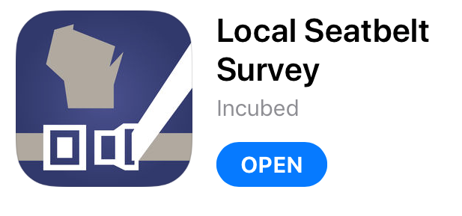
Do Your Own Belt Use Survey

Slide 2
Do Your Own Belt Use Survey
BEFORE using the App in the field:
Choose your location(s)
Decide how many observations & how much detail you need

Slide 3
Do Your Own Belt Use Survey
BEFORE using the App in the field:
Make sure your phone (or iPad) is charged up
Remember roadside safety rules
ANSI Class 2 vest
Stay out of the street!

Slide 4
Do Your Own Belt Use Survey
Let’s walk-thru the App:
Open the App
Click “Settings”
Set default EM address & minimum # of surveys
Click “Configure Survey”

Slide 5
Do Your Own Belt Use Survey
Choose details to be collected
Driver – Sex, Race, Age, Cell Phone Use
Passenger – Sex, Race, Age
Click “Done”
Return to Start Page
Notes:
Caution about expecting too much detail: NEVER ask for more data than you really need or are willing to compile
Two Rules of Thumb for “statistical validity”:
Get at least 30 observations total
Get at least 10 observations in each sub-category
Describe the Race and Age categories
Local results are likely to mirror long-term trends seen in statewide data:
Females are much more likely to buckle up than Males (but gap is narrowing)
Children and 60+ have always been more likely to buckle up (but young adults have improved greatly)
Pickup truck occupants are least likely to buckle up

Slide 6
Do Your Own Belt Use Survey
Click “Start New”
Weather
Traffic – Road Type, Speed Limit, Flow of Traffic
Location – Use Previous, Set New, Reset
Click “Get Started”
Notes:
If “Speed Limit” is 35 mph+, a warning message will appear regarding danger of standing next to high speed roadway
For “Flow of Traffic”, only click ONE direction
On iPad, SCROLL DOWN to see “Get Started” button → Will prompt if missing a “Location” value

Slide 7
Do Your Own Belt Use Survey
Begin entering data:
Record data for first vehicle
Click “Add” when done
Notes:
People using iPads will need to SCROLL DOWN to see Passenger buttons
NOTES:
All unselected data details will show up in muted/gray and no data can be entered
Enter Driver data first, then Passenger data → Click “Add” when done with the vehicle
If you failed to enter a value for EVERY data point, you will get a “Missing Values” prompt – Click “OK” and enter something where needed → Repeat until every field is complete, then click “Add”
Okay to “Set all Demographics to Unknown” at bottom of Driver or Passenger screen IF you don’t remember or could not determine every detail → Okay to enter “Yes/No” for belt use and leave other fields as “Unknown”

Slide 8
Do Your Own Belt Use Survey
Stop entering data:
After entering data for last vehicle, click “Complete Survey”
Enter short location name in “Comment”
Notes:
Will get a prompt about “Not enough recordings” if you have not met the minimum target value you set → Okay to click “Yes” and stop entering data → Click “Finish Survey”
“Comment” is a useful way to name the location if you’re doing surveys in more than one location → Keep it VERY short

Slide 9
Do Your Own Belt Use Survey
Repeat for new location or for new time at same location

Slide 10
Do Your Own Belt Use Survey
When survey is complete:
From Start Page choose survey data set
Data will be compiled as CSV data file and attached to E-Mail document
Confirm EM addresses and click “Send E-Mail”
Notes:
App users will get faster, more proficient with practice

